Slide 1
New Highest Possible Ambition Pathways Bill Hare Climate Analytics
14 November 2025

Slide 2
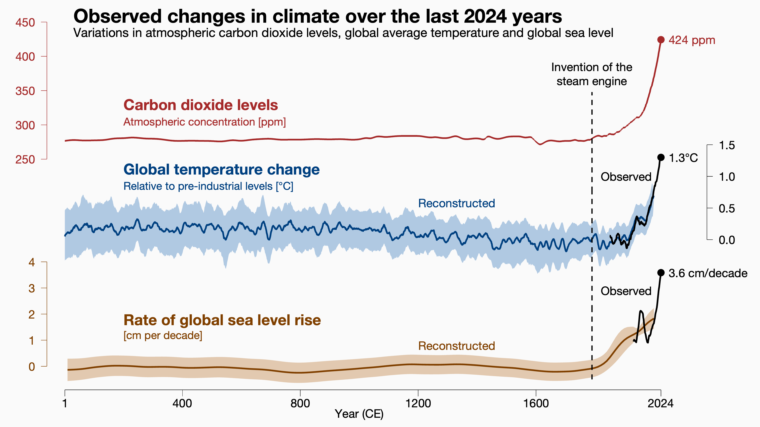
Climate system exiting the Holocene
https://ed-hawkins.github.io/climate-visuals/indicators.html

Slide 3
Entering 1.5ºC overshoot territory

Slide 4
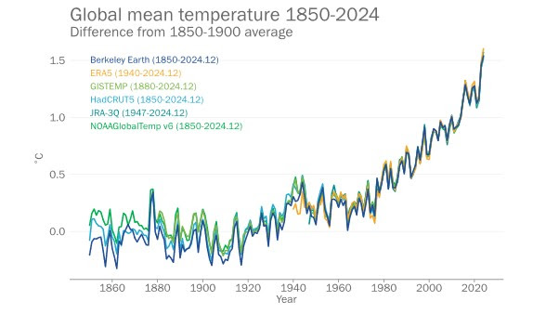
Annual average temperature close to 1.5ºC in 2024
WMO (2025)

Slide 5
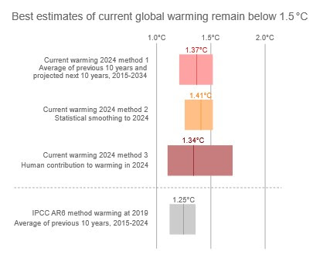
Where do we stand on 1.5ºC?
⁠The 1.5°C limit is about average human-induced warming over 20-30 years (long-term warming)
This figure looks at different ways of estimating long-term warming around the year 2024 – looking backward and forwards over 20 years (except for IPCC AR6 case focused on 2019 for comparison)
⁠The third, highlighted case specifically identifies human-induced warming averaged over 20 years around 2024
Human induced warming will likely reach 1.5° global annul average in about five years, by the early 2030s
WMO (2025)
Notes:
WMO (2025) - State of the Global Climate 2024 - https://wmo.int/sites/default/files/2025-03/WMO-1368-2024_en.pdf

Slide 6
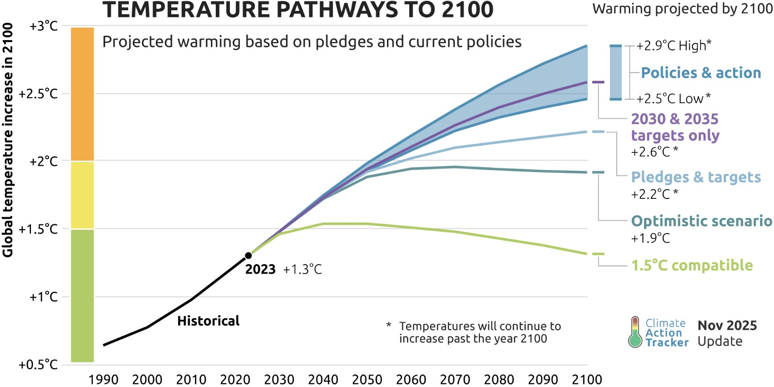
World is headed way above 1.5ºC

Slide 7
What could peak warming be limited to with maximum possible ambition?
Max temperature | Possibility | Discussion
<1.5ºC [No overshoot] | Almost certainly impossible | Failure to cut emissions from 2020–2025 Likelihood that the climate is running hotter than expected Make this almost certainly impossible
1.5–<1.6ºC [Low overshoot] | Very unlikely | If emissions are cut ~50% by 2030 And we get lucky on the climate response Low overshoot is still possible
1.6–1.7ºC | Achievable | If emissions are not halved by 2030 but still aggressive action is taken, peak warming could be limited to 1.6-1.7°C If net zero greenhouse gas emissions are reached by ~2070, then 2100 temperatures to <1.3ºC

Slide 8
What do the Paris Agreement climate goals mean?

Slide 9

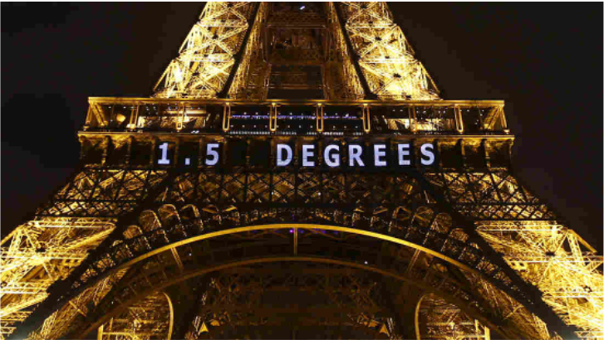
Paris Agreement climate goals
Article 2 1.5C limit
Hold warming well below 2º C, limiting increase to 1.5º C
“Holding the increase in the global average temperature to well below 2ºC above pre-industrial levels and pursuing efforts to limit the temperature increase to 1.5ºC above pre-industrial levels, recognizing that this would significantly reduce the risks and impacts of climate change”
Article 4 Net Zero
Net Zero GHG emissions in second half of century
“In order to achieve the long-term temperature goal set out in Article 2, Parties aim to reach a global peaking as soon as possible …, and to undertake rapid reductions thereafter in accordance with best available science, so as to achieve a balance between anthropogenic emissions by sources and removals by sinks of [GHGs] in the second half of this century”

Slide 10
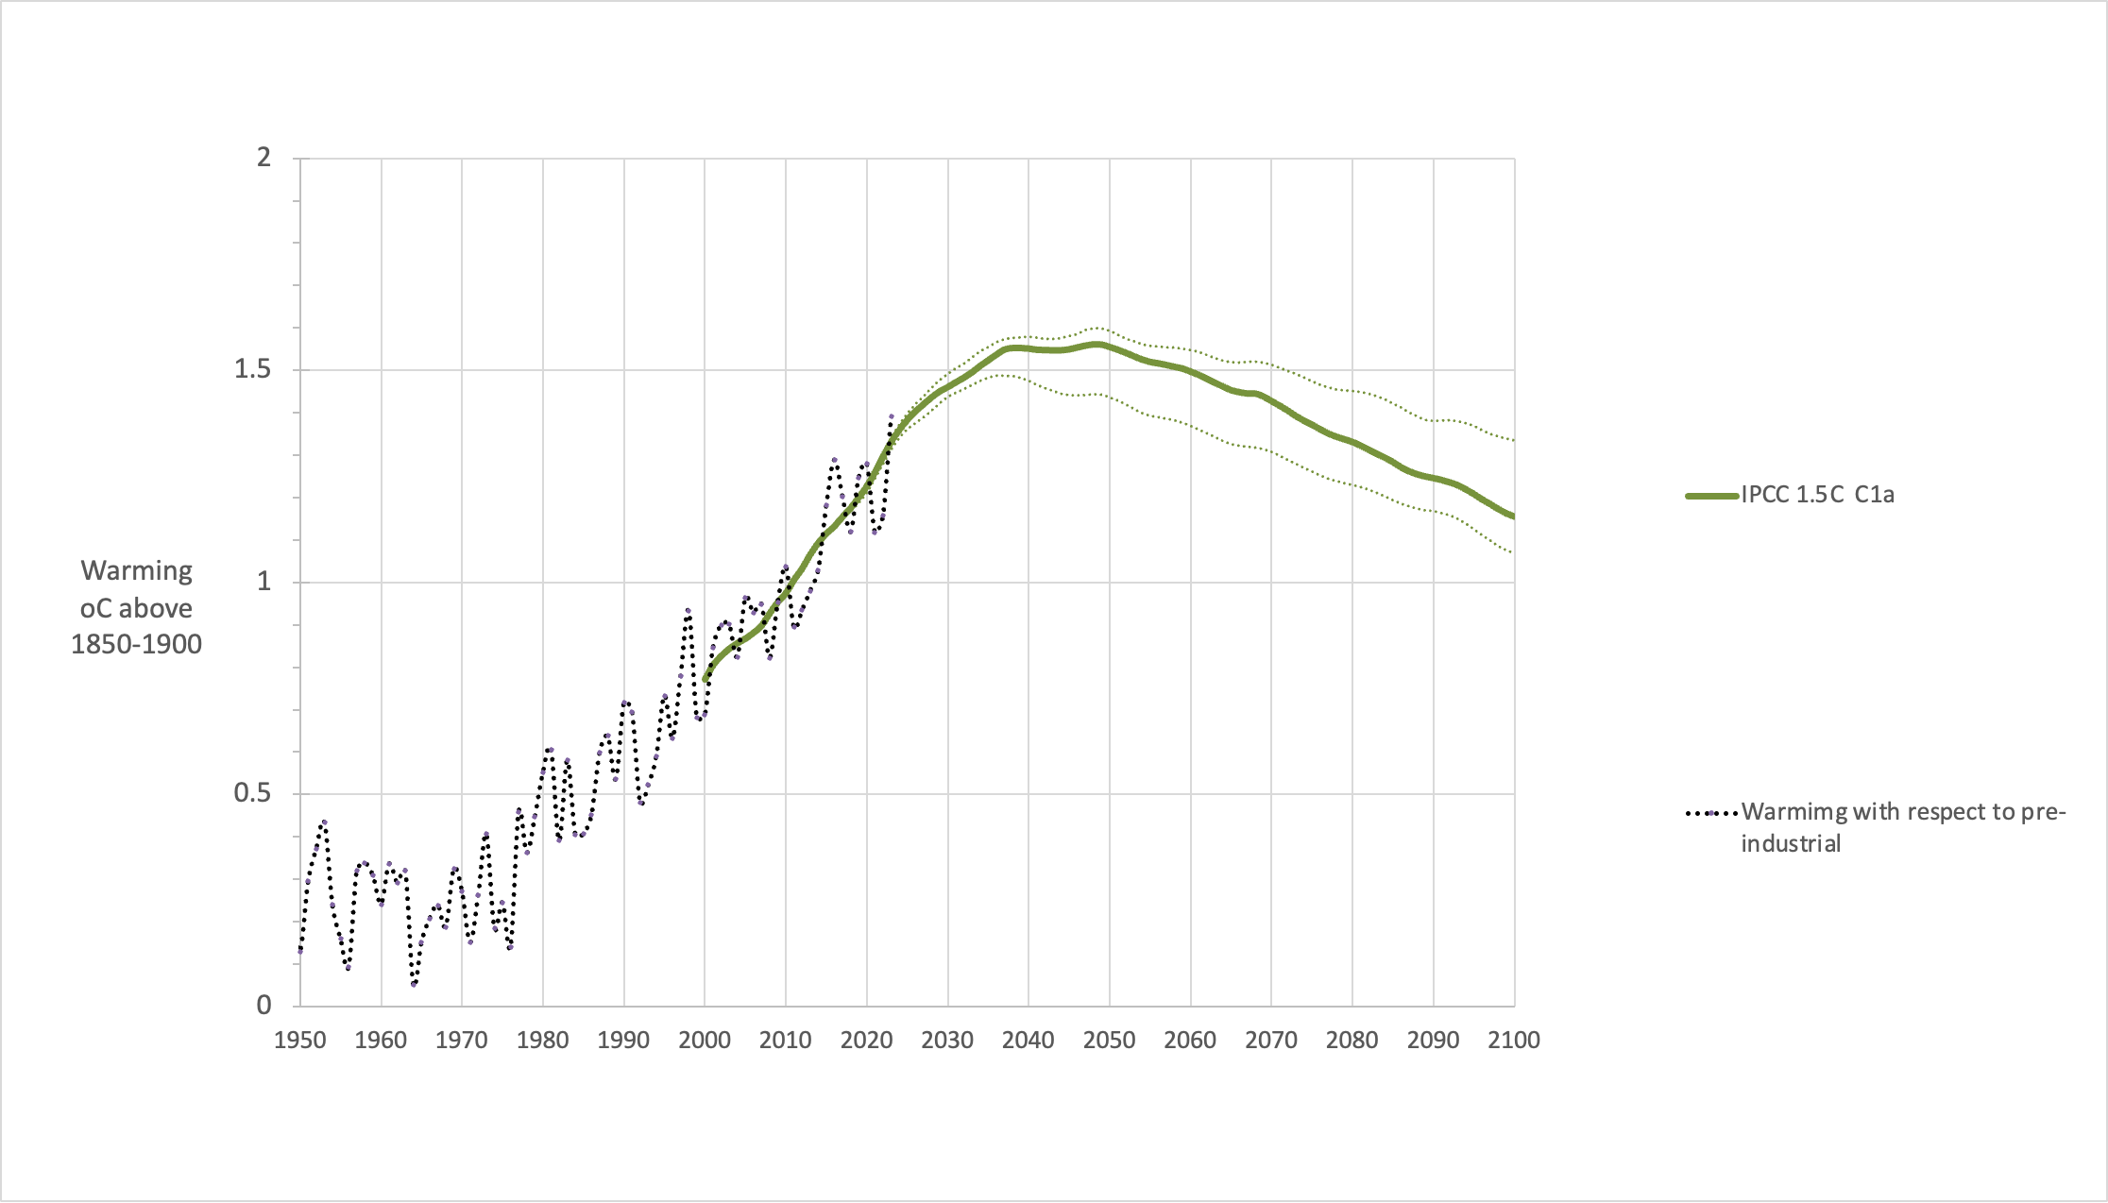
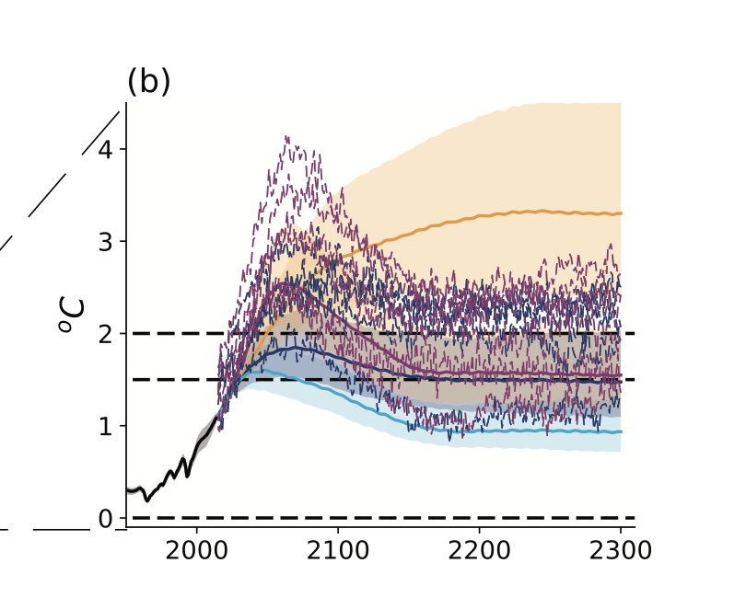
What does a Paris aligned global warming pathway look like
Peak warming <1.6ºC
Net zero GHGs by 2070s
Warming well below 1.5ºC by 2100 (~1.2-1.3ºC)
Oriented around SSP1‑1.9
The combination of Article 2.1 and 4.1 was designed to achieve this
Blue line is SSP1‑1.9 extended to 2300
From IPCC AR6 WGI Figure 4.40

Slide 11
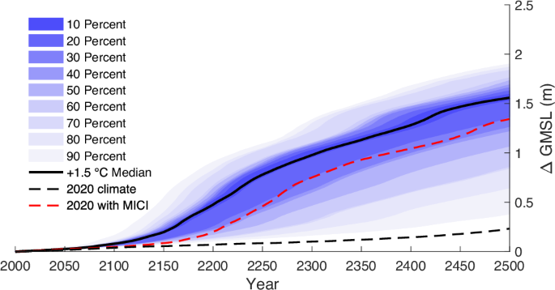
Sustained 1.5ºC warming will likely lock in massive sea level rise from Antarctica and Greenland ice sheets
+1.5°C is too high for ice sheets
Even current warming (~1.3ºC) if sustained will lead to several meters of SLR over centuries, causing major loss and damage
Global average temperature cooler than present, around +1°C, are needed
Stokes et al. (2025)
Fig.4

Slide 12
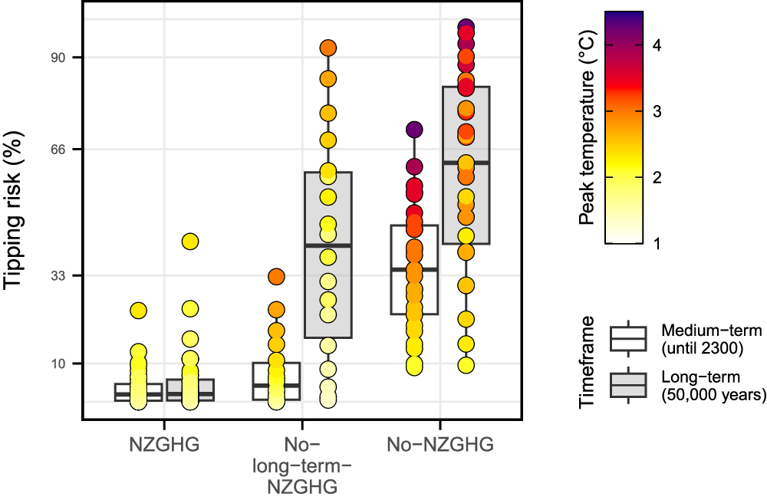
Tipping point risks increase rapidly above 1.5 °C and are only strictly limited with Net Zero GHGs
Four core tipping elements with planetary-scale impacts on the Earth system
Greenland Ice Sheet (GIS)
West Antarctic Ice Sheet (WAIS)
Atlantic Meridional Overturning Circulation (AMOC)
Amazon Rainforest (AMAZ)
Möller, Tessa, Annika Ernest Högner, Carl-Friedrich Schleussner, Samuel Bien, Niklas H. Kitzmann, Robin D. Lamboll, Joeri Rogelj, Jonathan F. Donges, Johan Rockström, and Nico Wunderling. 2024. “Achieving Net Zero Greenhouse Gas Emissions Critical to Limit Climate Tipping Risks.” Nature Communications 15 (1): 6192. https://doi.org/10.1038/s41467-024-49863-0.

Slide 13
How to rescue 1.5

Slide 14
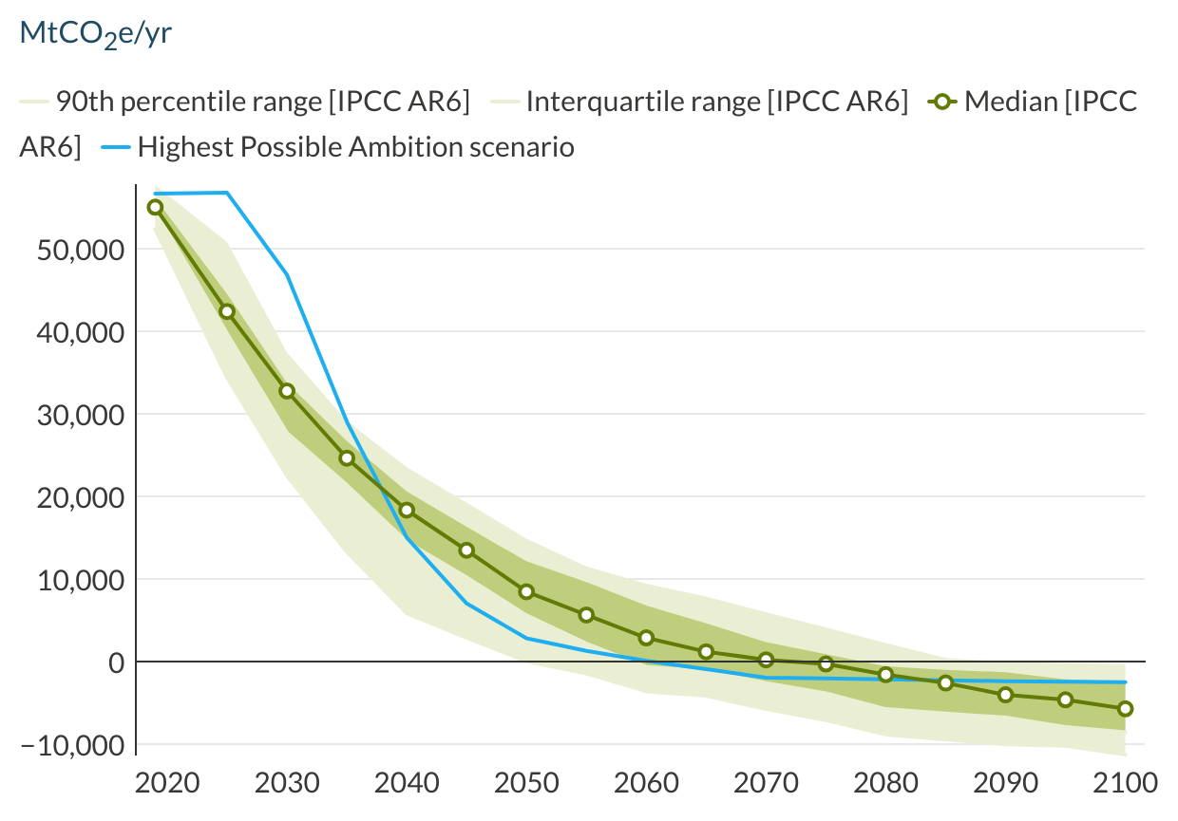
Global emissions start higher, fall faster, catch up with AR6 by the late 2030s, and reach net zero earlier
Presenting new scenario co-developed by Climate Analytics and PIK, with global action starting from 2025
Global emissions are higher until the late ~2030s than in IPCC AR6 C1a pathway (due to delayed start)
Global emissions are reduced more steeply by 2050
Net zero CO₂ reached in 2045, net zero GHGs reached ~2060, faster than median C1a scenario. This is essential to peak and then drive post-peak temperature decline
Time-period | AR6 scenarios | New scenario
2019–2030 | 41% | 17%
2019–2035 | 55% | 49%
2019–2050 | 85% | 95%
Notes:
IPCC AR6 C1a 1.5ºC emissions pathways are increasingly outdated
Emissions have grown over 2019–2025, rather than falling 25%
Improvements to models
Deeper electrification
New evidence on non-CO₂ emissions
Synthetic fuels

Slide 15
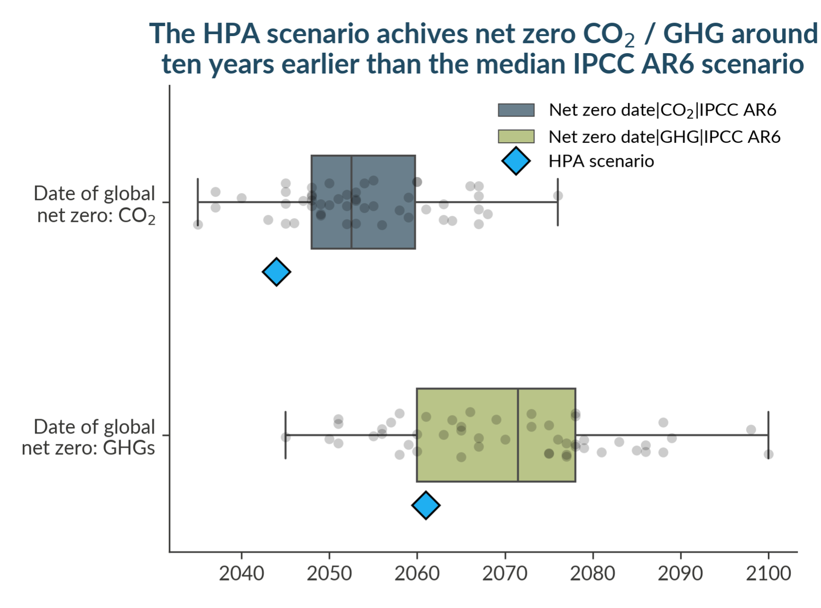
Dates of net zero are accelerated
While near-term emissions reductions are reduced, dates of net zero are accelerated
New scenario reaches net-zero CO₂ in the mid-2040s, 5 to 10 years earlier than the median IPCC AR6 C1a scenario
Net zero GHGs is essential to drive post-peak temperature decline. New scenario reaches net zero GHGs around 2060, 10 years ahead of the median C1a scenario

Slide 16
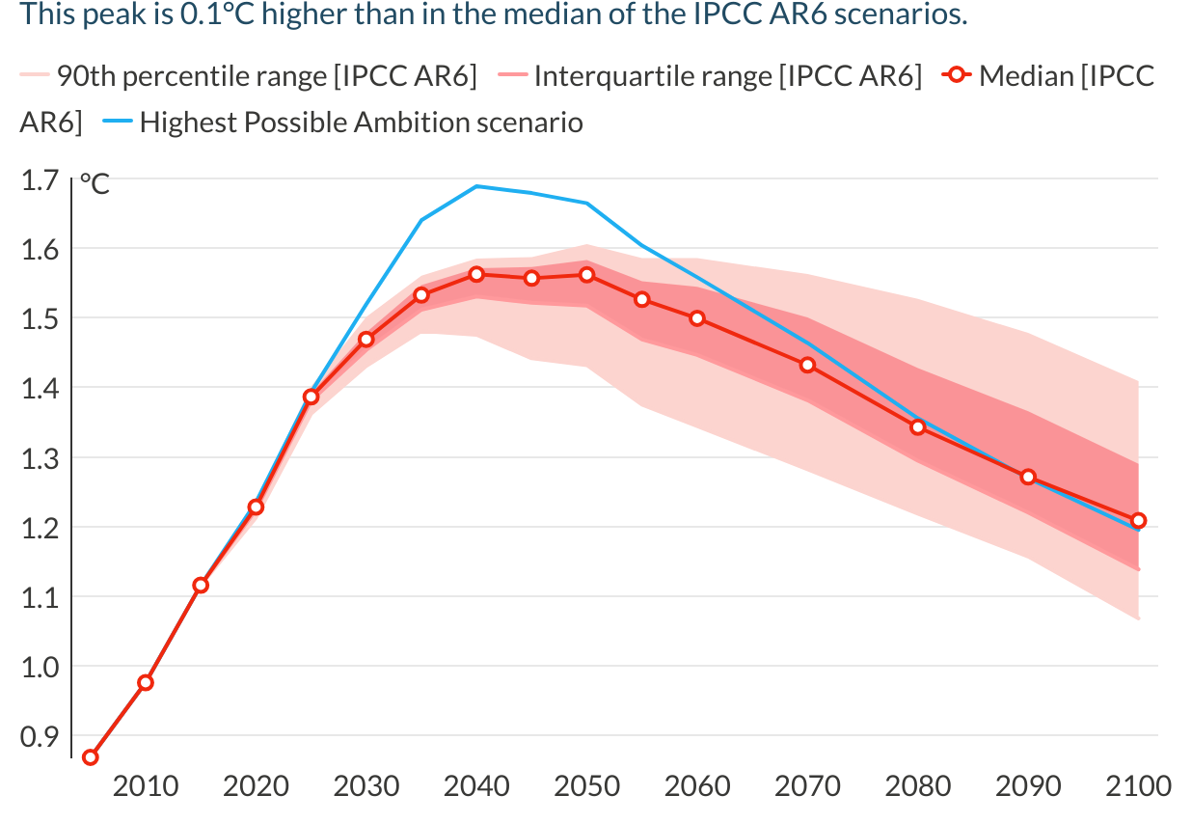
Global temperatures peak at ~1.7ºC but fall substantially below 1.5ºC pre-2100
Peak warming limited to 1.7ºC, 2100 temperature of 1.2ºC.
This does not account for post AR6 updates to climate system model calibrations that could push warming even higher
Overshooting 1.5ºC for ~40 years vs ~30 years in C1a
Table compares temperature outcomes to the IPCC AR6 C1a scenarios
Variable | AR6 scenarios | HPA scenario | IEA NZE 2025
Peak median temperature | 1.58ºC | 1.69ºC | 1.65ºC
2100 median temperature | 1.22ºC | 1.20ºC | 1.45ºC

Slide 17
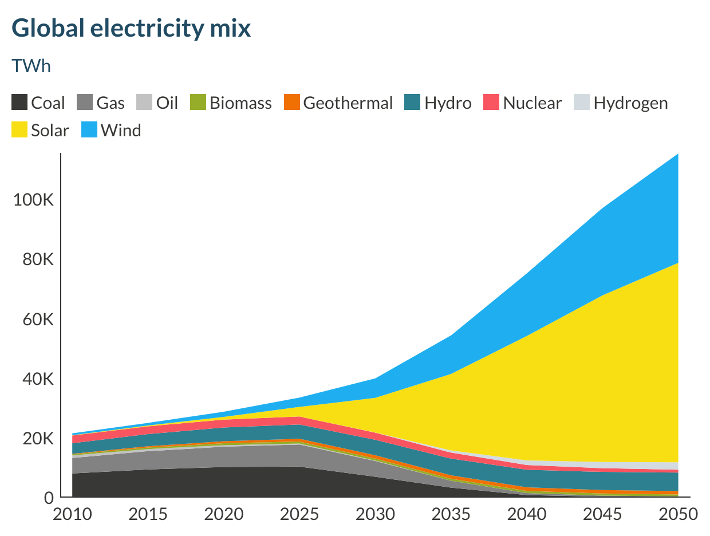
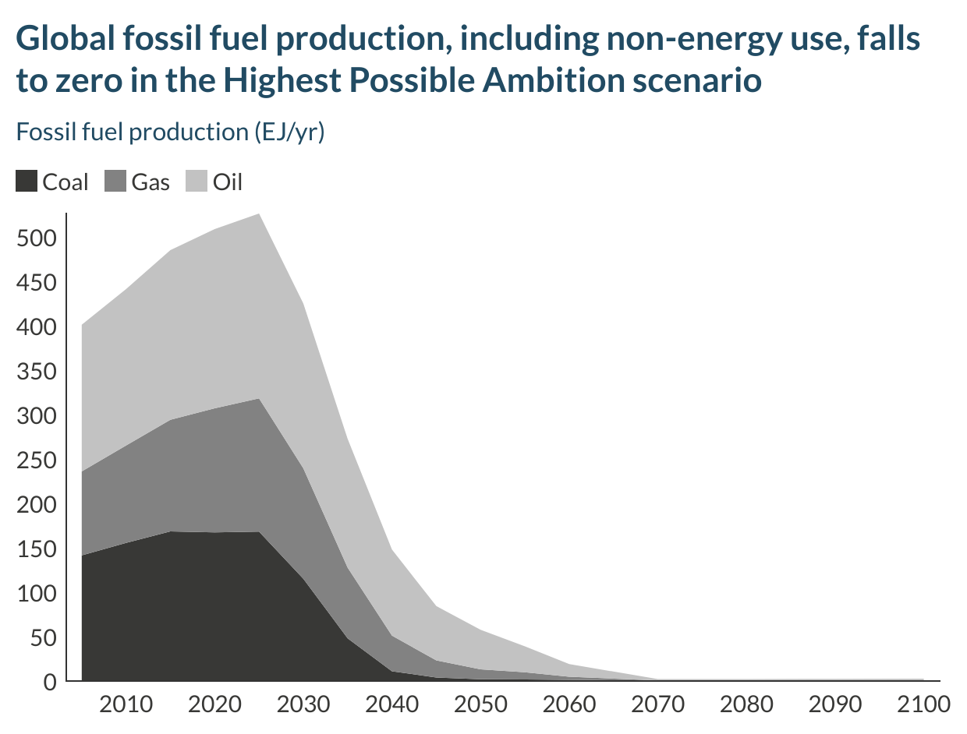
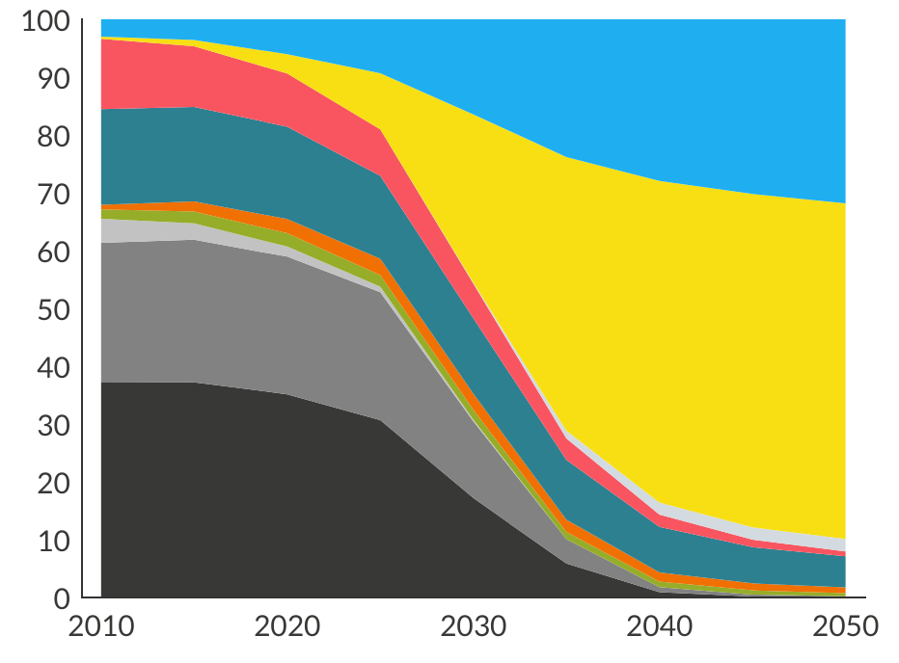
GST Implementation is needed - fossil fuel production must fall rapidly towards zero, and wind and solar dominate the system
Effective phaseout* of:
2040s for coal
2050s for gas
2060s for oil
Complete phaseout in the second half of the century
Without a fossil phaseout, limited CDR deployment will have to be used to offset continued fossil fuel demand
Electricity demand more than triples by 2050, driving electrification in all sectors
Total renewable capacity triples by 2030, 6x by 2035, 15x by 2050 (relative to 2022 levels)
* Defined as >95% reductions from 2020 levels

Slide 18
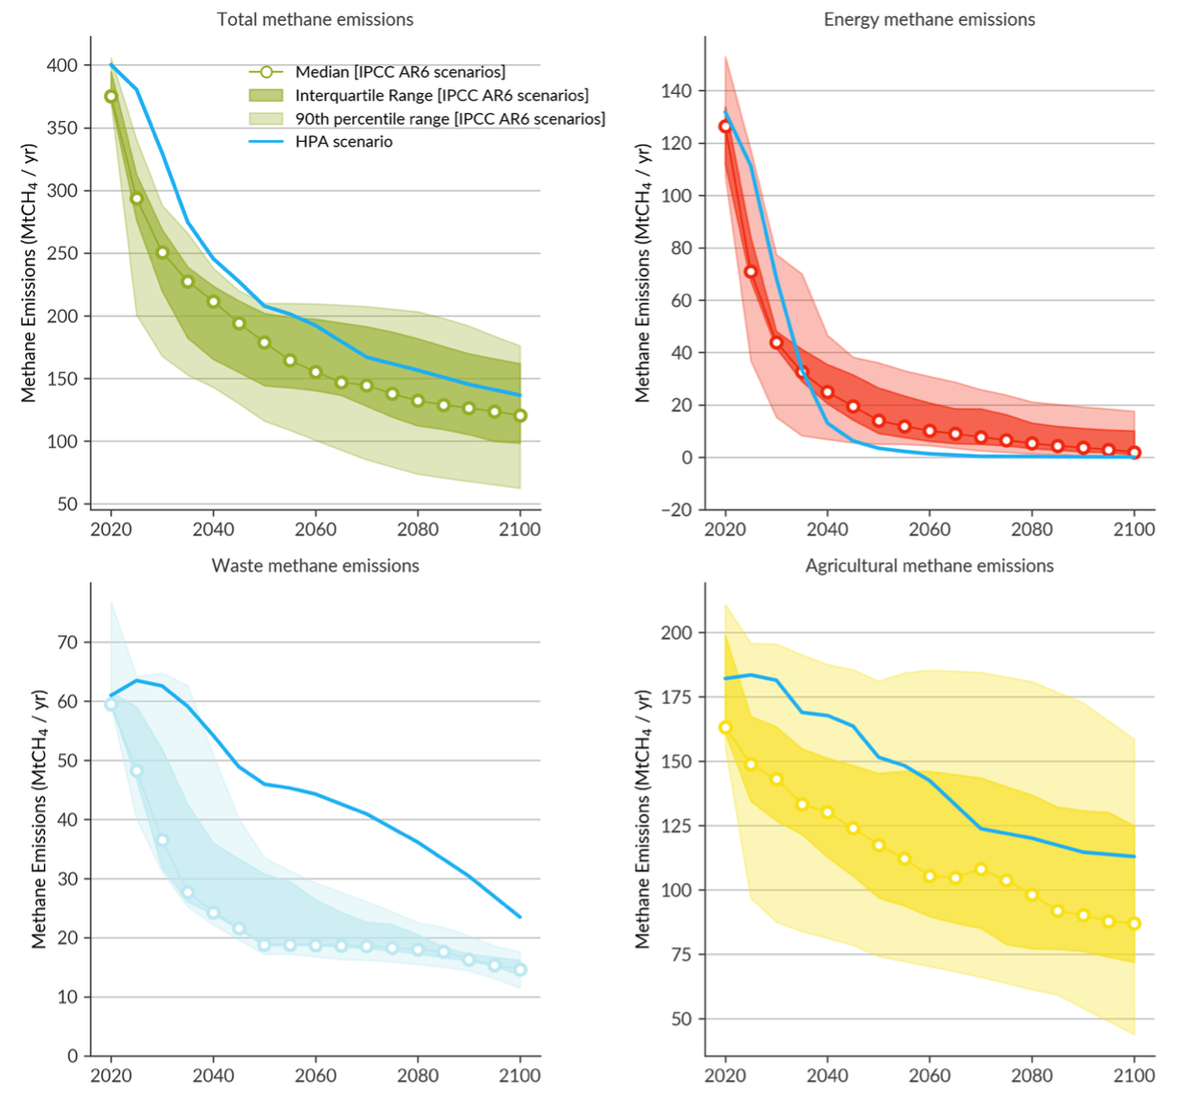
Deep reductions in methane help limit peak temperatures and drive post-peak decline
Methane emissions from the energy sector falls particularly rapidly
40% by 2030
70% by 2035
90% by 2035
Slower but still significant reductions in waste and agricultural methane
Global methane emissions fall 20% by 2030 (below Global Methane Pledge), but continue to fall strongly post-2030

Slide 19
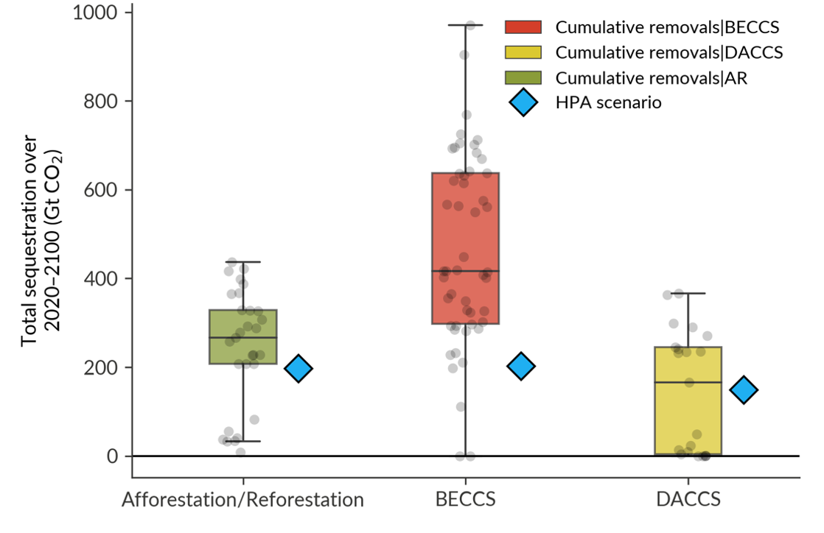
Carbon dioxide removal is a key lever
CDR deployment in this scenario broadly meets literature-defined sustainability/feasibility constraints
BECCS limited to 3 GtCO₂ / yr
DACCS reaches 2.5 GtCO₂ / yr in 2050 and 3.5 GtCO2 /yr by 2100
Land-use removes ~2 GtCO₂ / yr
CDR no excuse for prolonged fossil fuel use
CDR key for reducing post-peak temperatures and achieving net zero GHG emissions and then net negative GHG emissions

Slide 20
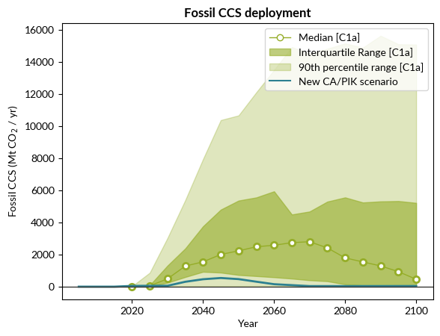
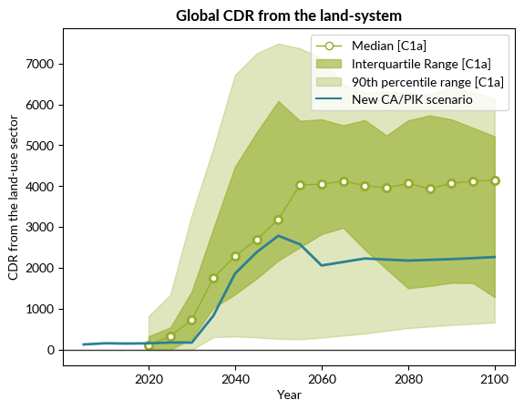
CDR kept to relatively low levels
Notes:
Land use removes ~2 GtCO₂ / yr
This broadly aligns with latest feasibility assessments
Lower reliance on land-use CDR than the AR6 scenario

Slide 21
New Highest Possible Ambition vs IPCC AR6 Paris aligned pathways
 | Peak warming | 2100 warming | Max overshoot and years >1.5
AR6 Paris Aligned (C1a) | 1.6ºC [1.4-1.6] | 1.2ºC [1.1-1.4] | 0.1ºC ~30 years
Highest Possible Ambition scenario | 1.7ºC | 1.2ºC | 0.2ºC ~40 years

Slide 22
1.5°C remains the right limit

Slide 23
Why 1.5°C remains the right limit
Current levels of global warming already have devastating consequences around the world. Keeping 1.5°C in reach minimises the worst impacts and risks, and loss and damage
Economic benefits from avoiding damages from climate change and from reduced adaptation costs increase with the stringency of mitigation
1.5°C is the benchmark for climate action, rooted in science, from the global to the local level
Achieving net zero CO₂ emissions would stabilise temperature increase and limit overshoot. Achieving net zero greenhouse gas emissions would lead to a long-term temperature decline
Affordable mitigation options available today can close the emissions gap. There is sufficient global capital available to close the global mitigation investment gap
Giving up on 1.5°C would lead to a backsliding of ambition and be a betrayal to the most vulnerable including SIDS

Slide 24


Slide 25
Thank you!

